Slide 1



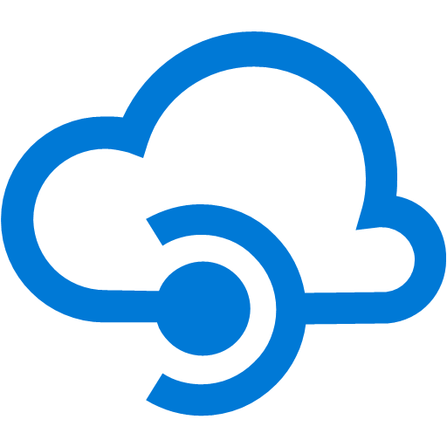
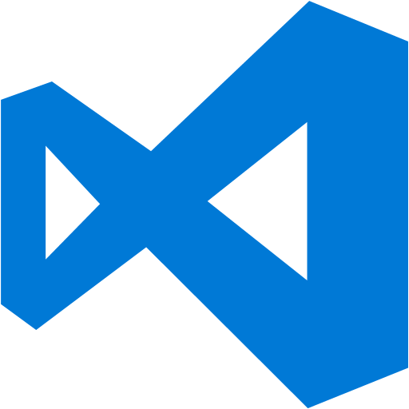


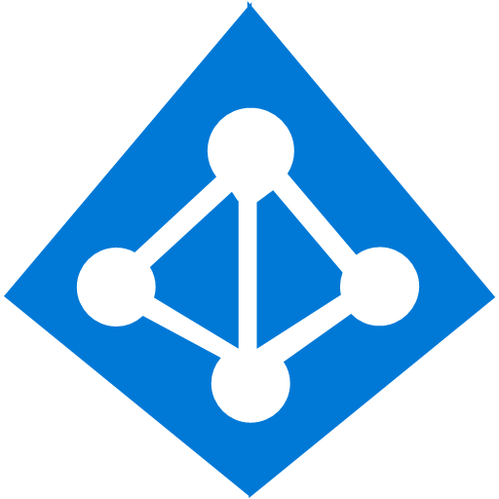








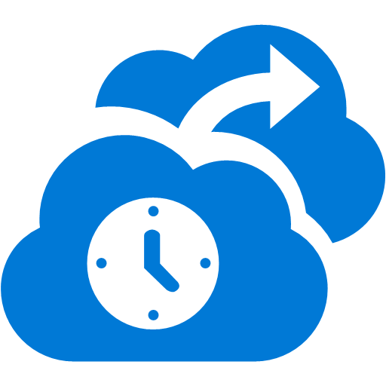

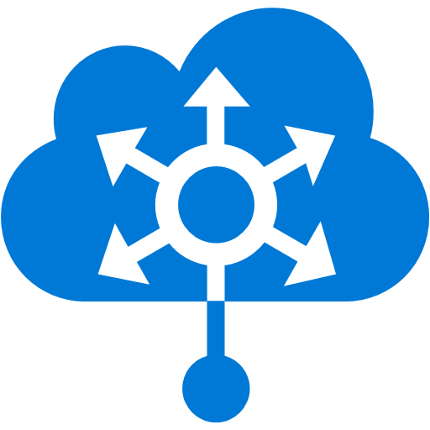

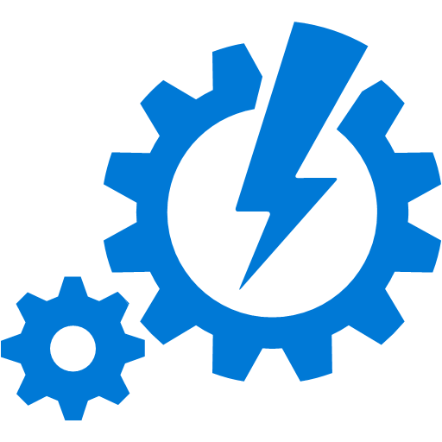



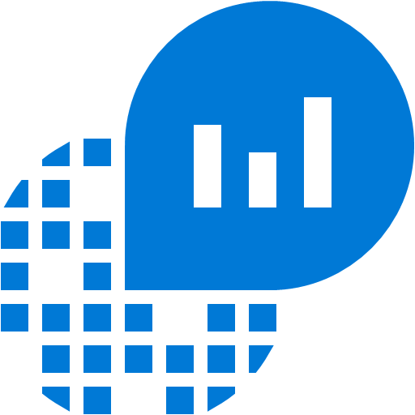

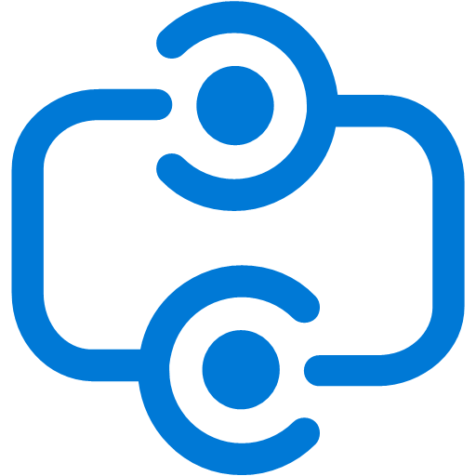
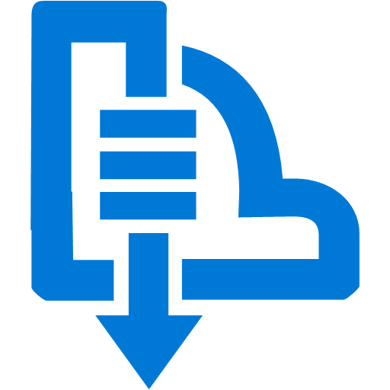

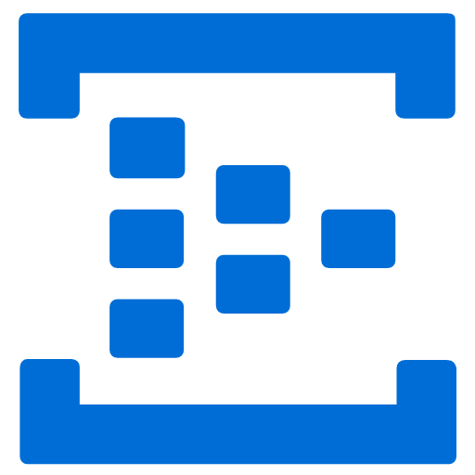
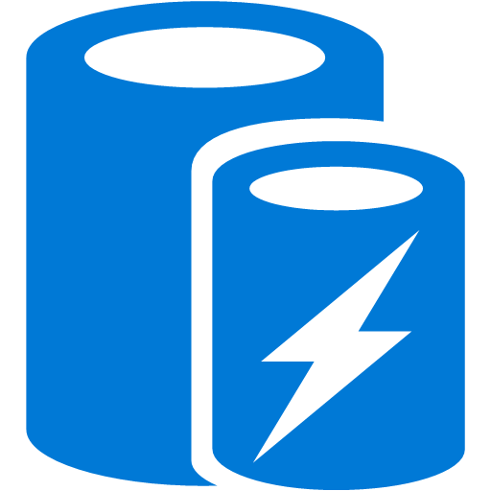
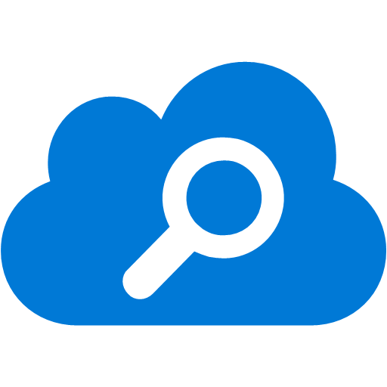


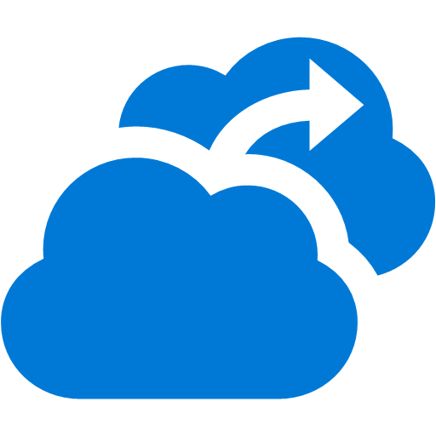






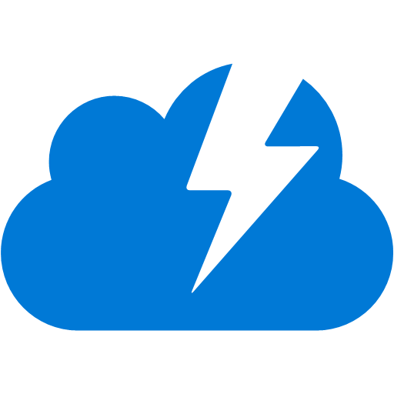
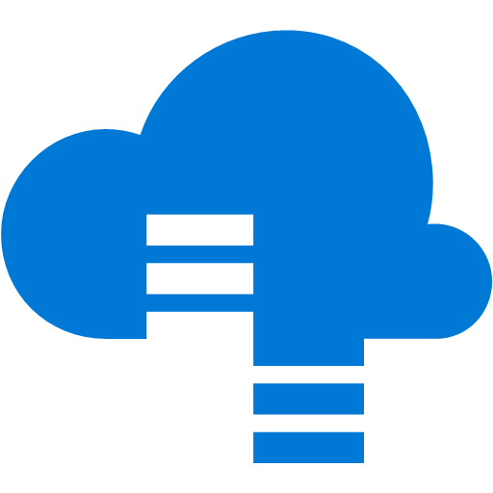



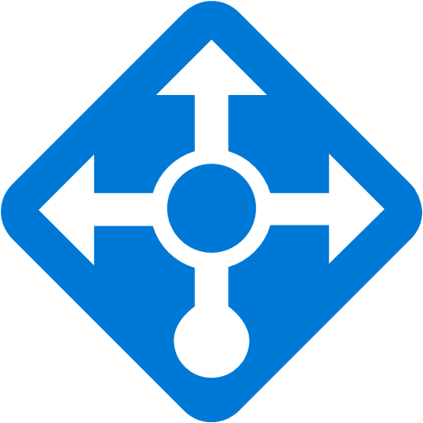

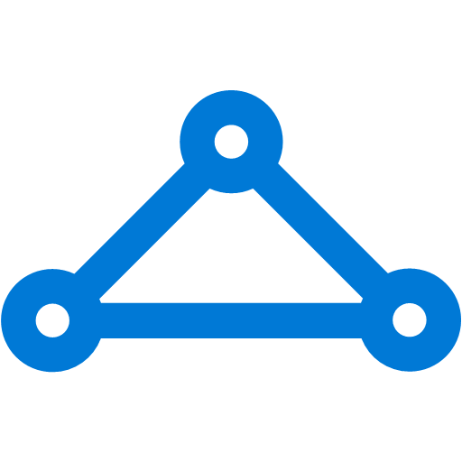



Platform Services
Security & Management
Compute
Web and Mobile
Developer Services
Hybrid
Operations
Cloud
Services
Service
Fabric
Web Apps
API
Apps
API
Management
Visual Studio
Azure SDK
Portal
Azure AD
Connect Health
Batch
Remote App
Mobile
Apps
Logic
Apps
Notification
Hubs
Team Project
Application
Insights
Active
Directory
AD Privileged
Identity
Management
Multi-Factor
Authentication
Integration
Analytics & IoT
Data
Backup
Storage
Queues
Biztalk
Services
Automation
HDInsight
Machine
Learning
SQL
Database
SQL Data
Warehouse
Operational
Insights
Hybrid
Connections
Service
Bus
Key Vault
Data
Factory
IoT and Event
Hubs
Redis
Cache
Search
Import/Export
Store /
Marketplace
Media & CDN
Site
Recovery
Stream
Analytics
Mobile
Engagement
DocumentDB
Tables
VM Image Gallery
& VM Depot
Media
Services
Content Delivery
Network (CDN)
StorSimple
Infrastructure Services
Compute
Storage
Networking
Virtual Machines
Containers
BLOB Storage
Azure Files
Premium Storage
Virtual Network
Load Balancer
DNS
Express
Route
Traffic Manager
VPN Gateway
Application Gateway
Datacenter Infrastructure (24 Regions, 19 Online)

Slide 2



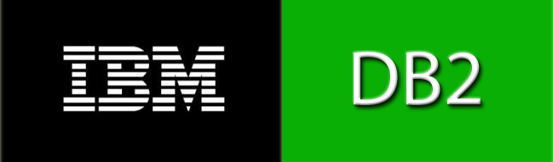
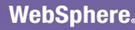
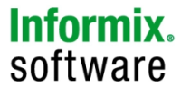
Introducing Azure IoT Suite
Connect and scale
with efficiency
Analyze and act
on new data
Integrate and transform
business processes
101010101101000110100010111
10101001110100101
Business Systems
Analytics
Real-time operating systems
And more
Device Registry
Rules and Actions
Dashboards & Visualization
Notes:
The Microsoft Azure IoT Suite provisions products and services within a subscription enabling an accelerated development of an IoT solution pilot or proof of concept. The elements within the Suite are highly customizable and allow for users to choose preferred OS’s, languages and platforms. Getting started and onboarding devices is simplified with documentation, libraries and SDK’s. Data processing, command and control and porting data to dashboards and LoB applications allows access to decision making information in real time. Integration with business systems and processes means business can be transformed quickly with an end-to-end Iot solution.
Benefit from a comprehensive solution
Connect and scale with efficiency
Perform rich real time analytics for split second decision making around the health and performance of a device ecosystem.
Analyze and act on new data
Store data and expose endpoints for in-depth data visualization to monitor trends over time.
Integrate and transform business processes
Integrate seamlessly with existing business applications or use the available code structures to develop a custom portal to monitor connected assets.

Slide 3
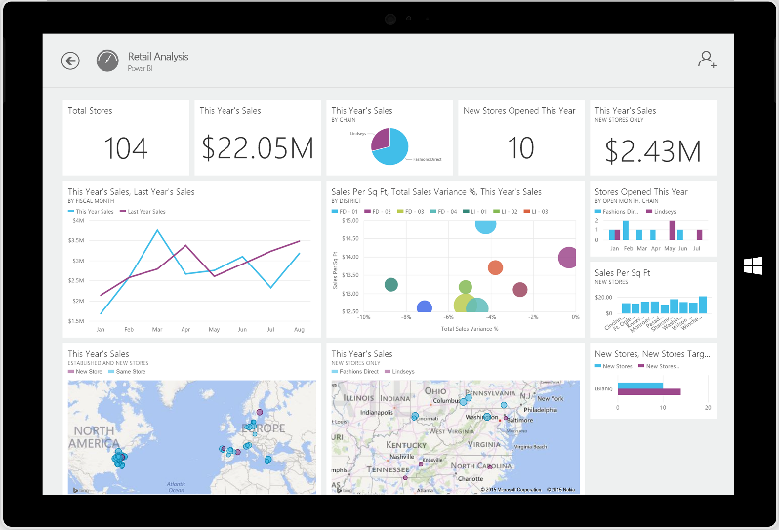
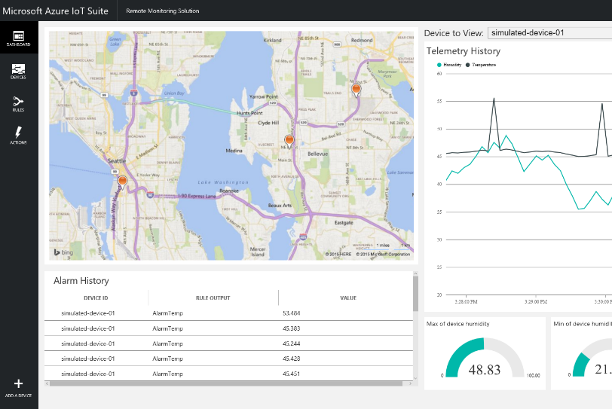
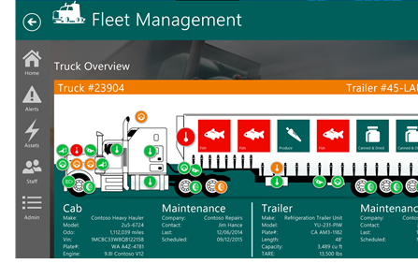
Tailor Azure IoT Suite to your needs using preconfigured solutions
Start quickly with preconfigured solutions
Finish with your Internet of Things application
Get started in minutes
Fine-tuned to specific assets and processes
Modify existing rules and alerts
Highly visual for your real-time operational data
Add your devices and begin tailor to your needs
Integrate with back-end systems
Notes:
The goal of the Azure IoT Suite is to quickly scale from a pilot to an enterprise grade IoT solution.
Explore an IoT platform with tailored simulated devices and dashboards and ultimately develop a full line of business portal or application utilizing the same system architecture and back end services. Build on top of the out-of-the-box dashboard to link to custom applications like the Fleet Management scenario above.

Slide 4
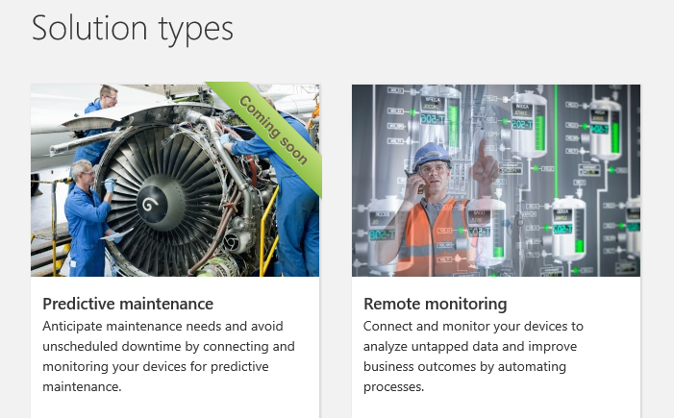
Azure IoT Suite Scenarios
http://www.microsoftazureiotsuite.com/demos/predictivemaintenance
http://www.microsoftazureiotsuite.com/demos/remotemonitoring
https://www.azureiotsuite.com/

Slide 5
What you get with remote monitoring preconfigured solution
Azure IoT Suite Remote Monitoring
Web/Mobile App
Power BI
Devices
Back end systems and processes
Storage blobs
DocumentDB
C# simulator
IoT Hub
Stream Analytics
Event Hub
Web Jobs
Logic Apps
Azure
Active Directory
Notes:
How does it work? As mentioned; the solution is a combination of multiple back-end components. This architecture diagram shows the individual Microsoft products and services that are utilized.
Reference Architecture for Remote Monitoring solution, what products are used and why? ->
Provision simulated devices with a C# device emulator running .Net. Create agents for Linux, iOS, Android and other platforms with C and Java language support.
IoT Hub manages the two way communication between cloud and device and creates a secure command and control channel.
Azure Stream Analytics creates and manages jobs to recognize threshold values or detect alarm triggers, sending this information where it needs to be escalated.
Event Hub is queried by a web job running an event processor host to determine where and alarm or alert needs to be pushed – such as sending an alert to dashboard for a human operator to take action.
Logic Apps are used to create more complex work loads and integrate into line of business and other proprietary applications.
Document DB stores all the metadata and device properties for each connected device.
Blobs store telemetry information and telemetry data. Other tools such as Azure Machine Learning and PowerBI can access this information for data visualization or processing advanced analytics.
Webapp – Dashboard code is available in Github allowing it to be fully customized by the user to align with a scenario or be relevant for an enterprise application.
Azure Active Directory controls user ID’s and access, allowing the service to be shared with relevant decision makers within the business but restrict access to certain controls or devices.
PowerBI is used for both open-source embedded components within the dashboard and also for complex external analytics of trends and patterns across all stored data.

Slide 6
Connect & Control Azure IoT Hub
Notes:
Connect and control - Azure IoT Hub.

Slide 7
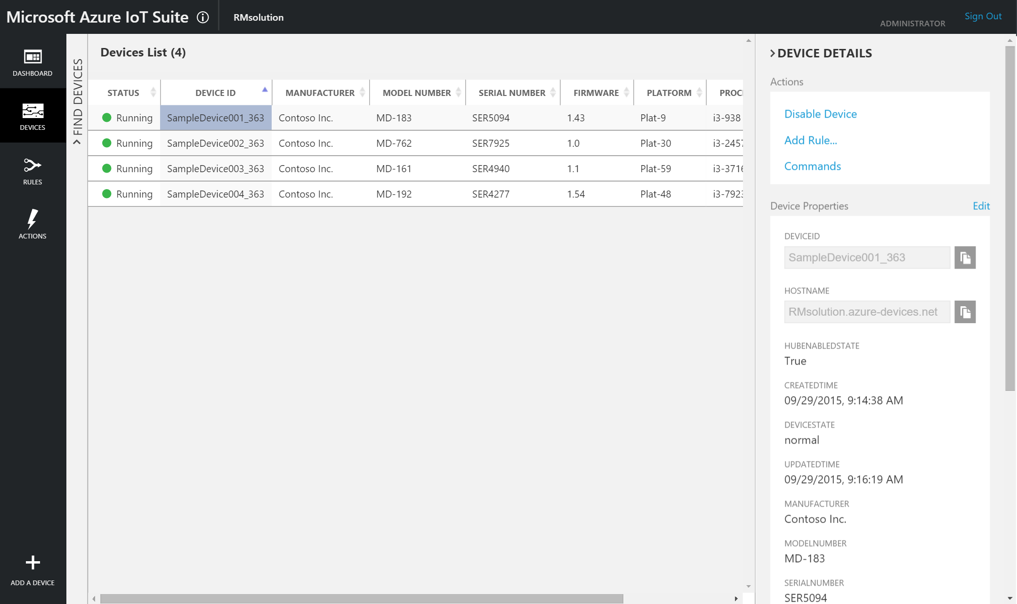
Notes:
IoT Hub is exposed through the IoT Suite preconfigured solution as seen above. Devices and sensors communicate with, and receive instructions via, IoT Hub. This allows for per device authentication and secure two way communication. Through the portal the user can access telemetry about the status of individual devices. They can ping for a response and easily identify a malfunctioning device. Rogue or unresponsive devices can also be removed from the solution. Simple device identification and alignment can also be achieved and monitored here.

Slide 8
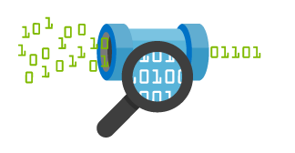

Connect your devices to Azure
IoT Hub
Event processing and insight
(e.g., hot and cold paths)
IP-capable
Cloud protocol
gateway
Device business logic,
connectivity monitoring
Field gateway
PAN-devices
Application device provisioning and management
field
cloud

Slide 9
IoT Hub endpoints
Your IoT Hub
Event processing
(hot and cold path)
Device
Device ID
D2C receive endpoint
D2C send endpoint
Device business logic,
connectivity monitoring
C2D queue
endpoint
C2D send endpoint
Field GW/
Cloud GW
Msg feedback and monitoring endpoint
Device …
Device …
Device provisioning and management
Device identity management
Device …
IoT Hub management

Slide 10
Azure IoT Hub
Designed for IoT
Connect up to 10 million devices
Service assisted communications
Secure bi-directional communication
Command and control
Cloud-scale messaging
Device-to-cloud and Cloud-to-device
Durable messages (at least once semantics)
Cloud-facing telemetry ingestion
Delivery receipts, expired messages
Device communication errors
Per-device authentication
Individual device identities and credentials
Connection multiplexing
Single device-cloud connection for all communications (C2D, D2C)
Multi-protocol support
Natively supports AMQP, HTTP
Designed for extensibility to custom protocols
Multi-platform
Device SDKs available for multiple platforms (e.g. RTOS, Linux, Windows)
Multi-platform Service SDK.
Notes:
As a component IoT hub offers massive scalability with support for up to 10 million devices per instance. Additional instances can be created if required. Secure two way communication and command control (to a device level) can be achieved through IoT Hub. Device health telemetry can be displayed through the IoT Hub portal in the preconfigured solution offering real time insights into the performance of a device. Communication errors and faulty assets can be identified and flagged for attention or simply removed from the system. Tighten security through per device ID and credential authentication. IoT Hub natively supports AMQP and HTTP protocols and is designed to extensively support custom protocols where required. Multi platform SDKs are available for different OS’s and languages.
IoT HUB:
Connect up to 10 million devices per instance
Secure two way communication
Command and control
Monitor device health and connectivity
Troubleshoot individual devices
Native AMQP, HTTP support – custom protocol support
Multi platform SDK support for RTOS, Linux, Windows
Per/device authentication

Slide 11
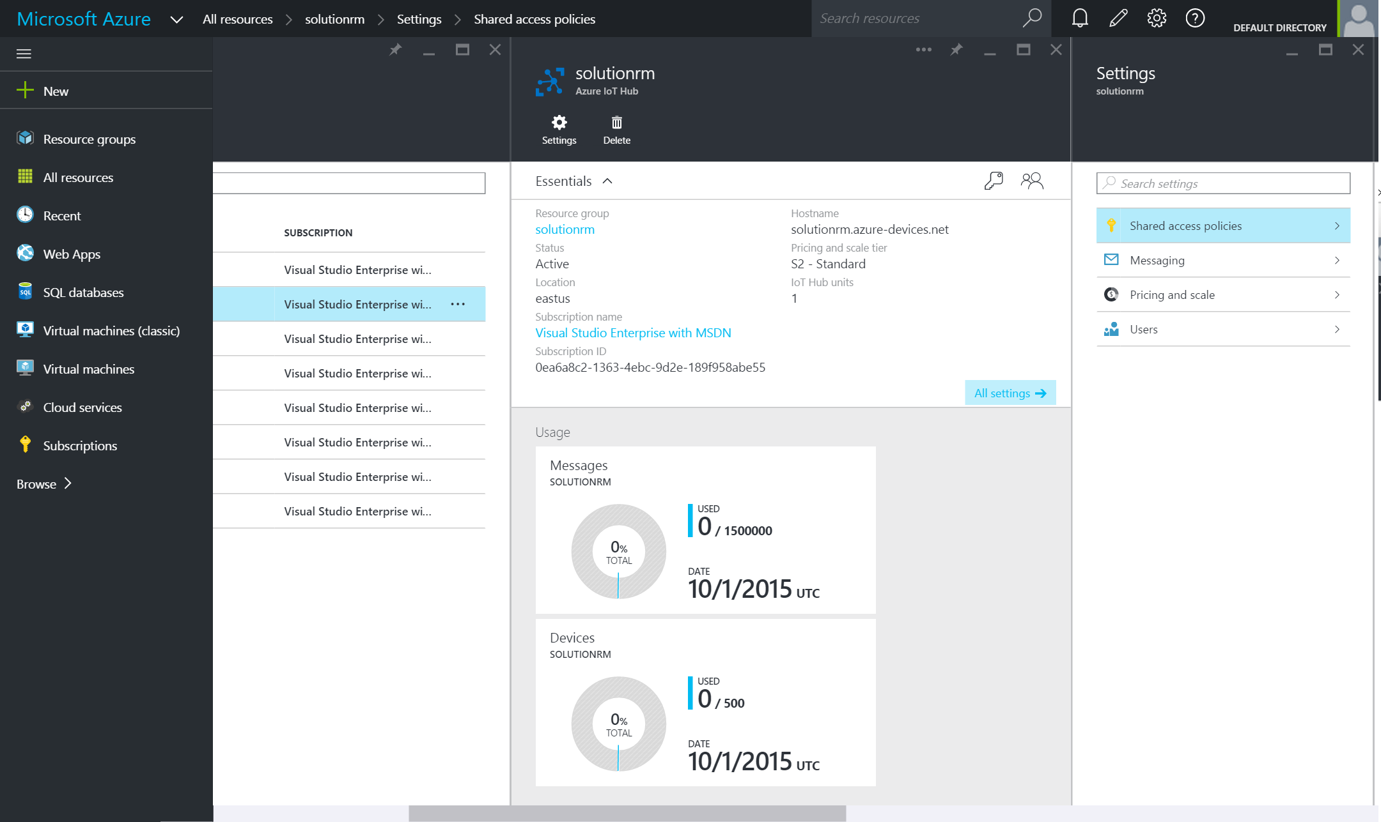
Manage IoT Hub in Azure portal
Simple navigation
Management of devices, volume and scaling made easy through the IoT Hub settings in the Azure Management Portal

Slide 12
Event Processing Azure Stream Analytics
Notes:
Event Processing – Azure Stream Analytics.

Slide 13
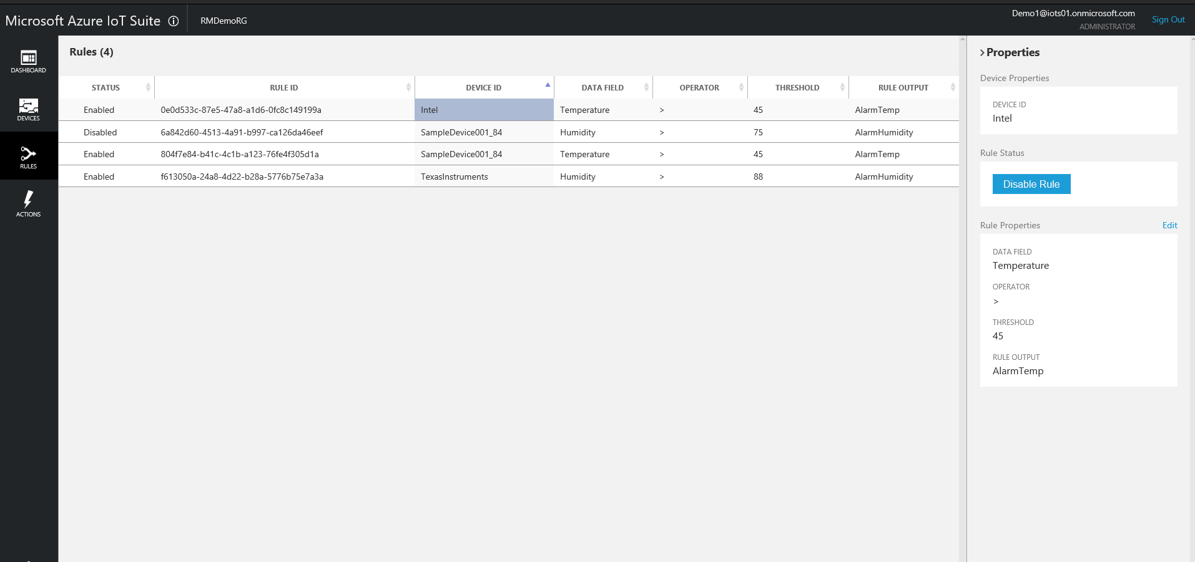
Notes:
Azure Stream Analytics offers the processing, analytics and handling of massive amounts of real time data. ASA is exposed in the preconfigured solution for the setting of rules and alarms. ASA then runs these rules as it processes the incoming data ingestion and flags what needs to be escalated for attention. Use simple SQL syntax to program if-this-then-that style rules and instructions.
Azure Stream Analytics:
Real time event processing (massive data)
Flag rules/events for attention
Build rules with simple SQL syntax.

Slide 14
Real time event processing
Uncover real time insights
Perform real time analytics across multiple streams
Rapid Deployment
Use simple SQL syntax, auto distributed for scale
Mission critical reliability
Fully managed, low latency, high throughput
Create real time alerts
Flag alerts and alarms for attention
High volume
Analyze millions of data points per second
Highly scalable
Enterprise grade, predictable solution.
Notes:
ASA can not only handle millions of events per second but it can also correlate across multiple independent streams of data simultaneously. This high speed event processing allows for the real time detection of anomalies or escalations based on threshold breaches or alarm settings as the data is ingested. The architecture is simple and easily scalable to an enterprise ready solution.
Azure Stream Analytics:
Real time analytics
Millions of events per second
Low latency, high througput

Slide 15
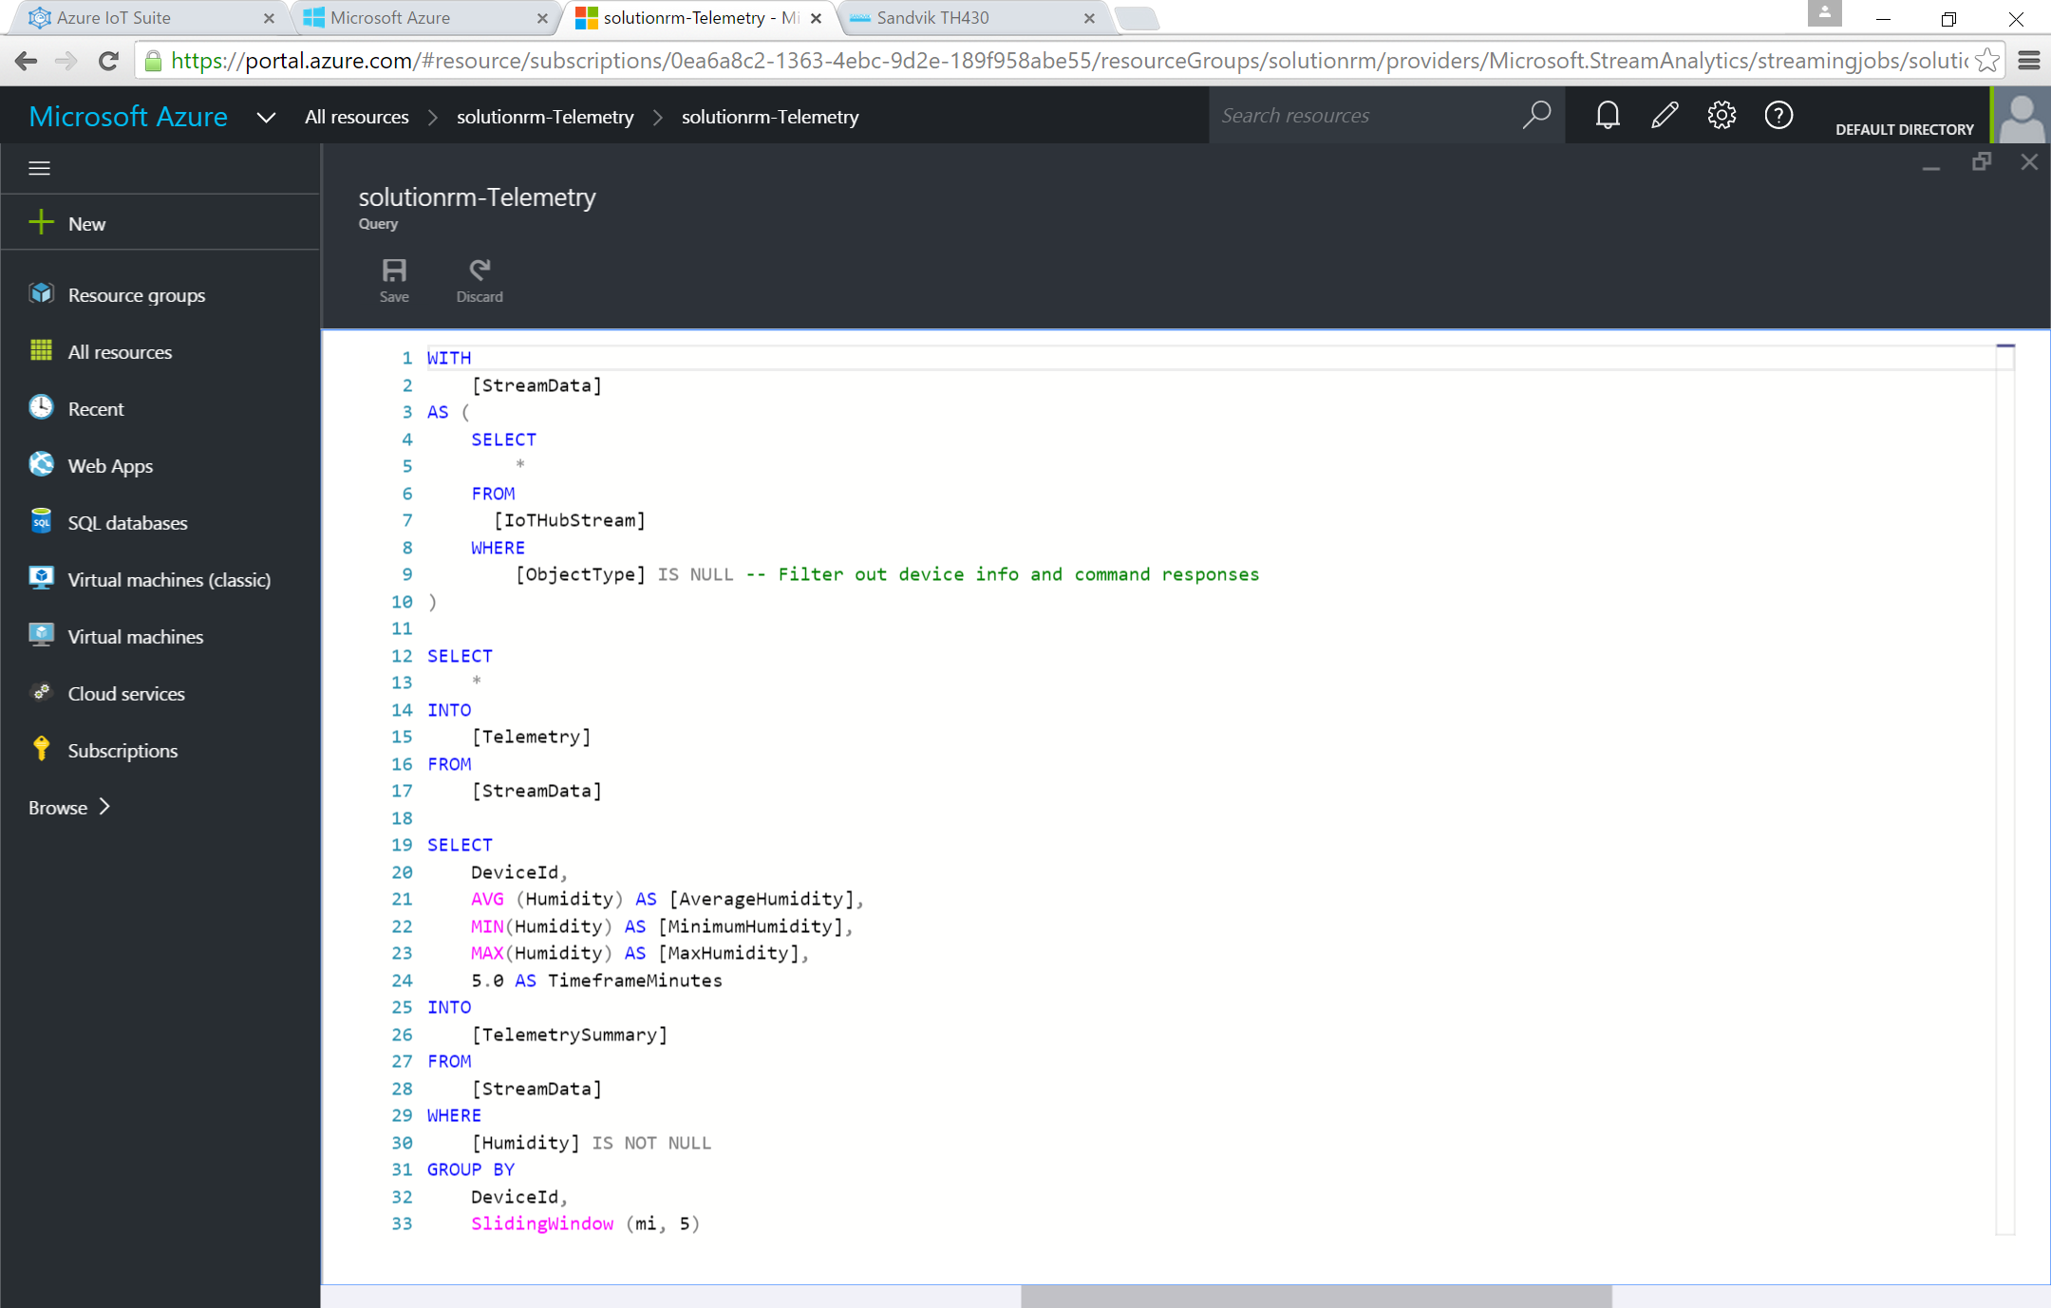
Add or edit jobs using simple ASA interface
Rule based interface
Simple implementation and rule development using ASA UI.
Multi-channel
Analyze multiple channels of information simultaneously, in real time.
Notes:
Utilize the simple ASA rule based interface within the Azure Management Portal to create, manage and control rules.
Azure Stream Analytics:
Simple interface for rule development and management

Slide 16
Data Visualization Power BI
Notes:
PowerBI – Data Visualization

Slide 17
Data visualization with PowerBI
Highly accessible analytics
Cloud based dashboard and analytics tool,
360º view of business KPI’s
Customize dashboards to address concerns and performance metrics.
Cross platform support
View data via web platform, on any device
Pre-built dashboards
Utilize standard dashboards for rapid deployment, based on popular solution demands.
Real time capabilities
Ingest, analyze and display data as it happens
Secure access
Secure, live communication with data source
Query data
Intuitive, natural language query tool
Integrated systems
Integrate with other business systems and enrich device data with intelligence from other business systems, eg: CRM, ERP
Notes:
PowerBI is a cloud based (with desktop capabilities) dashboard and analytics tool. Quickly develop deep-dive dashboards for a 360-degree view of important business metrics. Data can be easily called and analyzed within a dashboard, drilled down deeper and even queried with native language search functions for ad-hoc requests or simple dashboard development. Integrate simply to other line of business by pushing feeds or embedding assets within other applications.
PowerBI
Cloud based analytics
Preconfigured dashboards
Easily view KPI’s
Native language queries
Integrate/embed in existing or proprietary systems

Slide 18
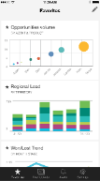
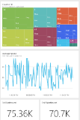
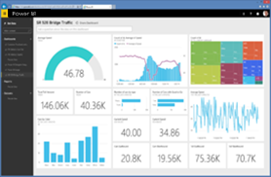
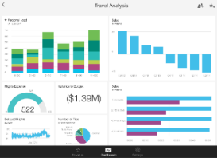
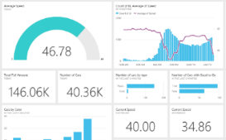
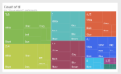
Power BI Overview
Data sources
Power BI service
SaaS solutions
e.g. Marketo, Salesforce, GitHub, Google analytics
Content packs
Natural language query
Sharing & collaboration
On-premises data
e.g. Analysis Services
Live dashboards
Organizational content packs Corporate data sources or external data services
Visualizations
Azure services
Azure SQL, Stream Analytics…
Reports
Excel files
Workbook data / data models
01001
10101
Power BI Desktop files
Data from files, databases, Azure, and other sources
Datasets
Data refresh
Notes:
Let’s walk through an overview of how Power BI works.
1. The Power BI service, sometimes referred to as powerbi.com, is what allows you to:
Create beautiful visualizations to tell compelling data stories
Build rich, live dashboards that turn BI into business insights
Create reports & datasets from which you can create visualizations and dashboards
Enjoy the benefits of up-to-date data with real-time, automatic and scheduled refreshes
Share dashboards easily with other people in your organization
Ask questions of data in plain English with Natural Language Query
Stay connected to your data all the time with mobile applications
2. Power BI connects to a variety of data sources. These range across both cloud and on-premises sources, and include:
A variety of popular SaaS solutions, such as Marketo, Salesforce, GitHub, Dynamics CRM, Zendesk, and several others
On-premises databases – Power BI offers live connectivity to SQL Server Analysis Services, which we’ll cover in more detail later. And using a gateway solution, Power BI can connect to other database solutions.
Custom data sources – Power BI can connect to any data source you need it to thanks to its extensibility via REST APIs. This includes both proprietary corporate data sources, as well as external data services. For example, if you are a SaaS solution provider, you can work with Microsoft to connect your solution to Power BI.
Other Azure services – Power BI integrates tightly with SQL Azure and Stream Analytics, and will be integrating closely with more Azure services over time
Power BI Desktop and Excel files – Excel workbooks can be directly connected to Power BI.com, or may be used with Power BI Desktop. Power BI Desktop is a companion application to the Power BI service – it is a desktop tool that supports data analysis and reporting. Like Excel files, Power BI Desktop files may be uploaded to the Power BI service.

Slide 19
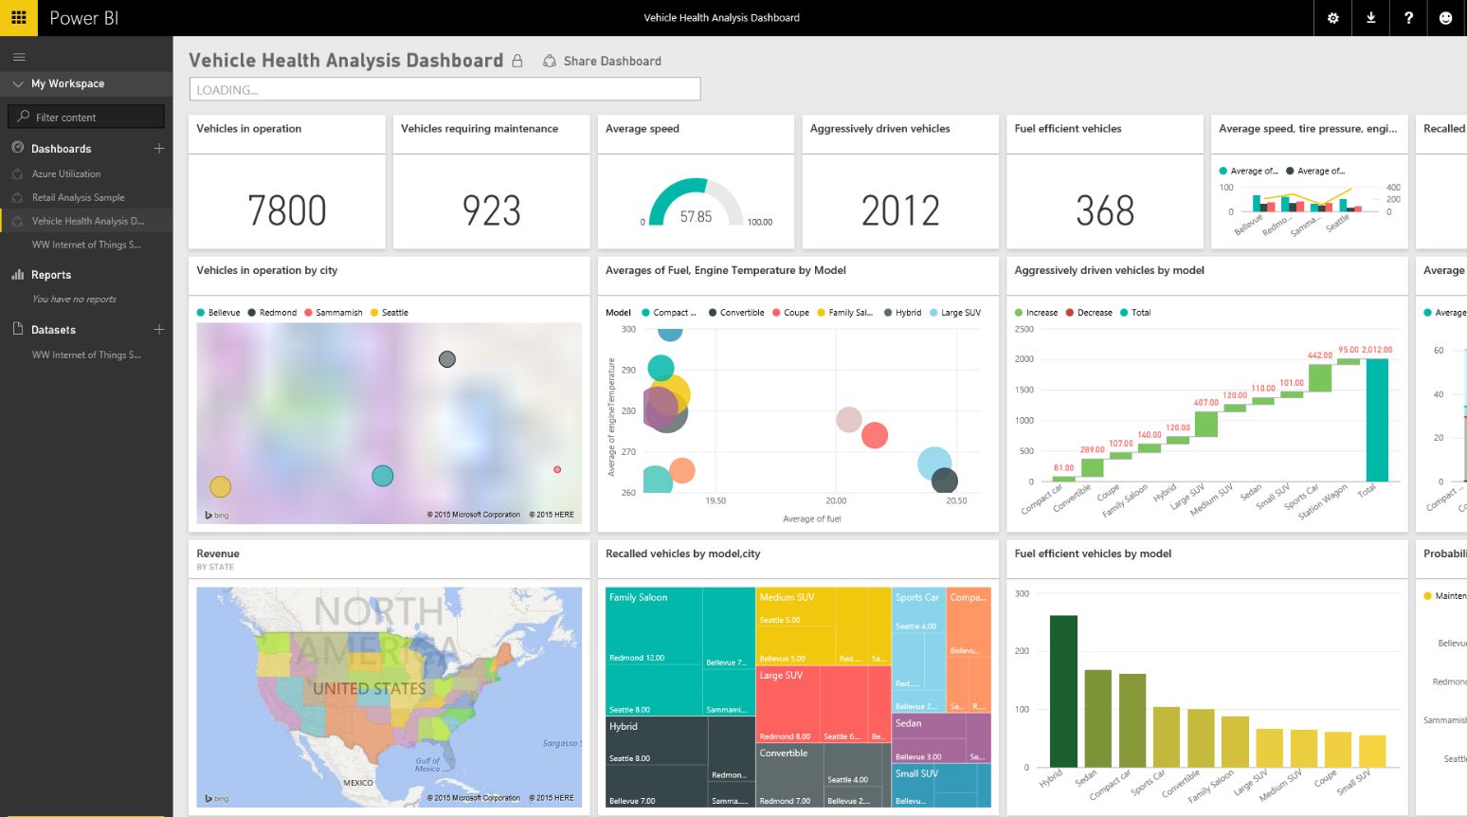
Data visualization with PowerBI
Rich visuals
Standard and custom graphing options
Custom dashboards
Build heat maps and visually track data
External data
Integrate external data feeds to add value to device data, or pull in external information such as weather or market information.
Notes:
Device data can be enriched by adding external data. Content packs are easily available within the PowerBI portal to add external information such as weather or traffic to name a few. Also integrate existing/proprietary/on-prem data from other business flows such as CRM or ERP. This allows the user to create very powerful overviews of the business and pull all data sources together for forecasting and business analysis.
External Data Integration
Integrate external data sets
Add other internal information flows – CRM/ERP
Global view of performance/health across business

Slide 21
Workflow Integration Logic Apps
:

Slide 22
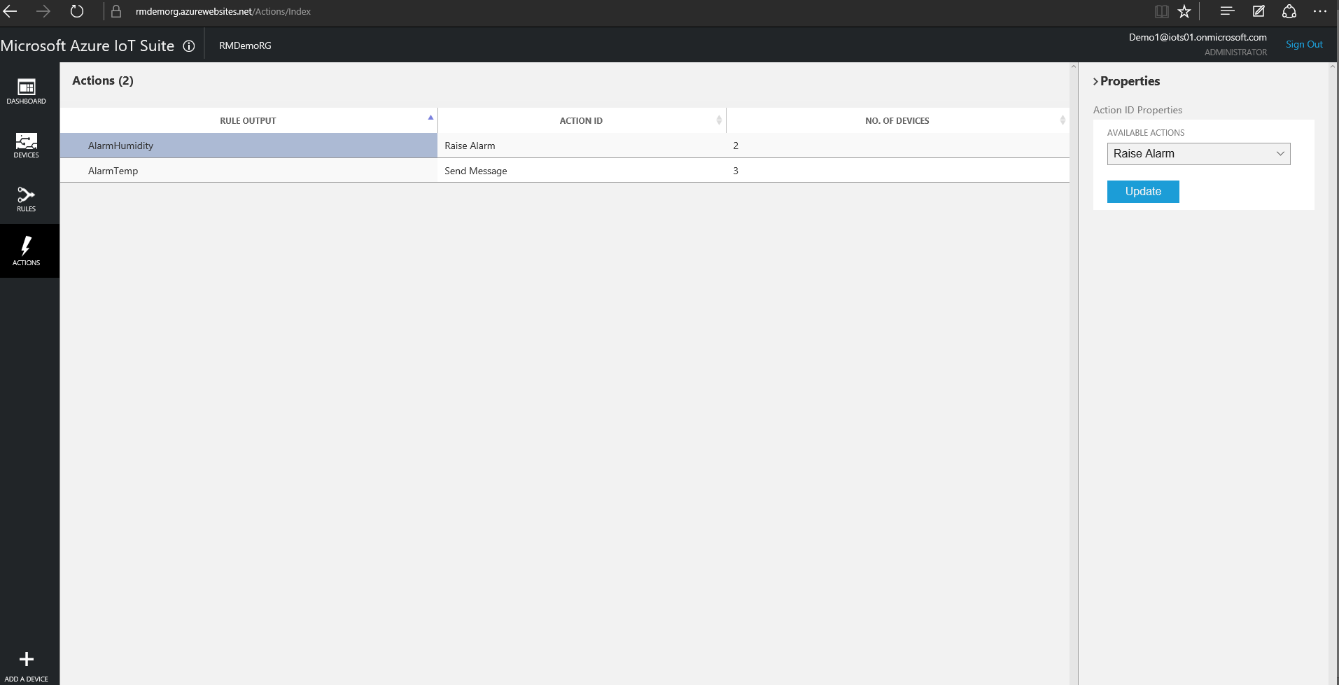
Notes:
Logic Apps are used to create and manage complex workflows, integrating ingested data, alarms and alerts into line of business and existing applications. The Logic Apps UI is exposed within the IoT Suite to allow simple rule creation to outline the flow of information if an alert or alarm is created.
Logic Apps
Integrate with LoB applications
Simple rule/trigger creation

Slide 23
Integrate with business systems
Create workflows
Visually create processes and workflow, automated actions and trigger responses
Cross platform
Integrate with new, existing or custom business solutions on any platform
Connect to on-premises data
Utilize on-prem/cloud hybrid integration solutions
Standard and custom connectors
Library of supported external connectors, or create custom ones.
Line of business integration
Push intelligence, alerts and alarms to existing LoB dashboards or solutions.
Highly automated
Automate EA, B2B and business processes
Notes:
Workflows and connections can be integrated and highly automated with Logic Apps. Utilize cross-platform capabilities and connect to both cloud and on-prem data flows. Standard, premium and customer connectors are available and easily integrated with a drag and drop UI in the Azure Management Portal.

Slide 24
Integrate with business systems
Standard connectors
Azure HDInsights, Azure Service Bus, Azure Storage Blob, Box, Chatter, DropBox, Facebook, FTPS, HTTP, Microsoft Office 365, Microsoft OneDrive, Microsoft SharePoint, Microsoft SQL Server, Microsoft Yammer, POP3, QuickBooks, SFTP, SMTP, Salesforce, SugarCRMC, Twilio, Twitter
Custom connectors
Create custom connectors and API’s.
Premium connectors
AS2 Connector, BizTalk EDIFACT, BizTALK X12, BizTALK Trading Partner Management, BizTALK JSON Encoder, BizTALK Rules, DB2 Connector, Informix, MQ, Oracle DB, SAP, BizTALK Flat File Encoder, BizTALK Transform Service, BizTALK XML Validator, BizTALK Xpath Extractor
Notes:
Standard, premium and custom connectors.

Slide 25
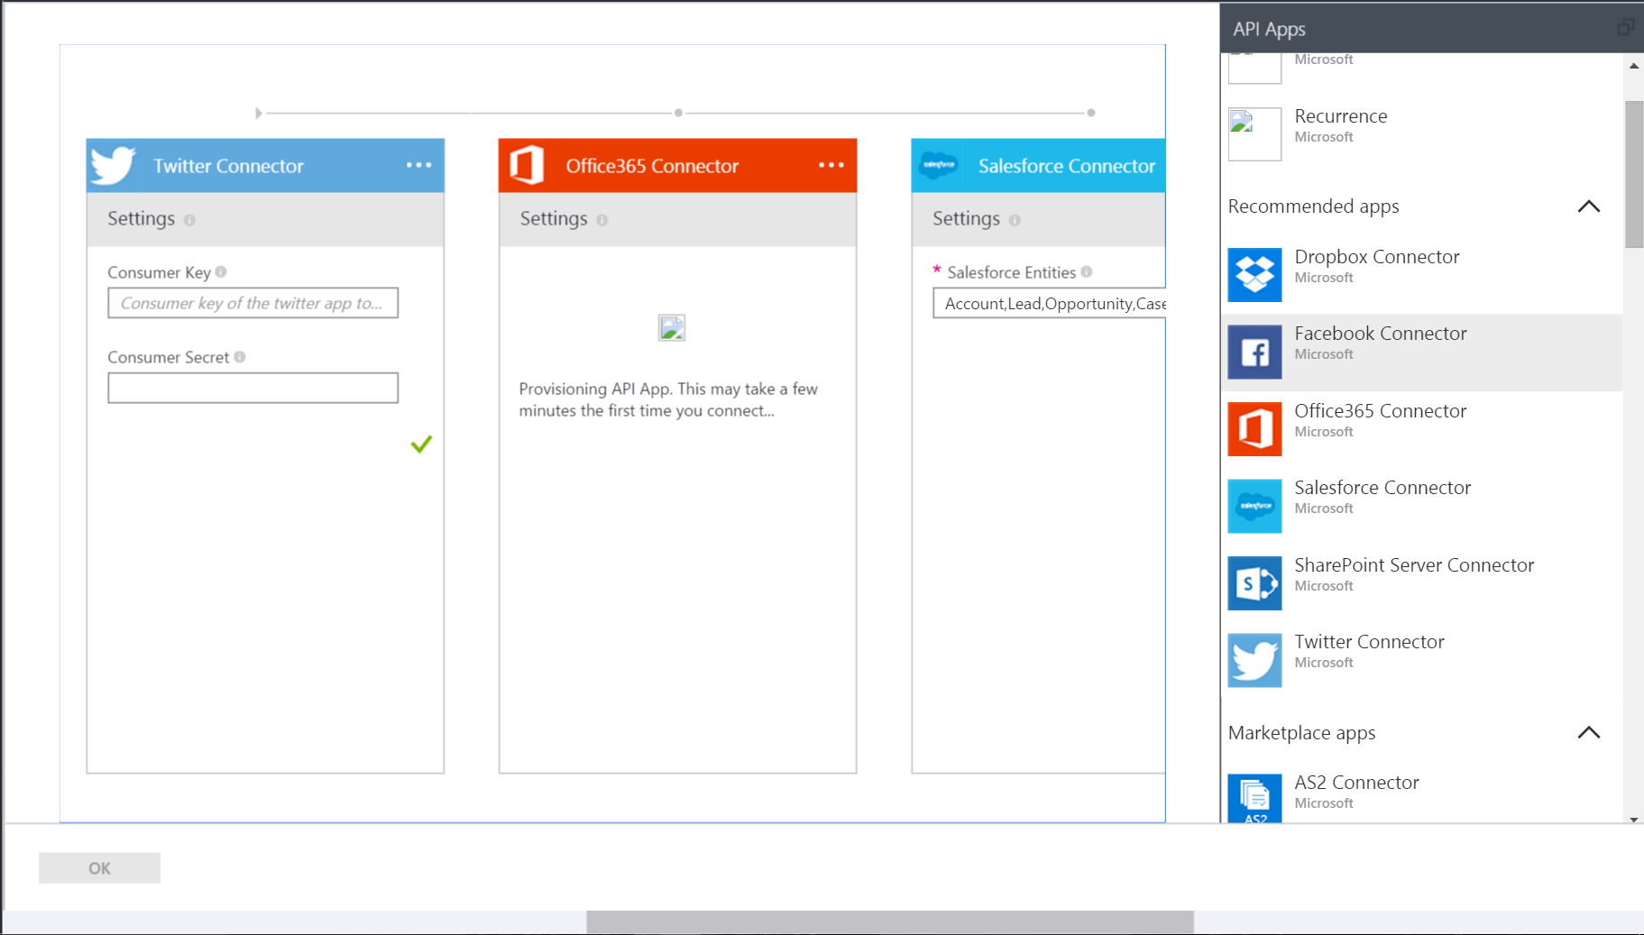
Drag and drop connector integration
Drag and drop UI
Simple connector integration
Authentication
Enter product keys and authentication data
Notes:
Connector integration is made simple with the drag and drop UI within the Azure Management Portal. Select from lists sorted by use case and create rules and information flows to quickly integrate systems.

Slide 26

Push & Broadcast Notifications Notification Hubs
Notes:
Notification Hubs – Push & Broadcast Notifications

Slide 27
Broadcast notifications to any backend
Reach all major platforms
Support across iOS, Android, Windows, Kindle etc
Broadcast from major backends
.Net, PHP, Java, Node.js, cloud/on-prem hybrids.
High capacity
Broadcast to millions of devices from a single API call
Customize audience
Target devices based on location, language, status
Scale instantly
Ramp up and deploy to millions of devices without the need to rearchitect the solution
Secure communication
PNS managed authentication credentials per device, per message.
Receipt telemetry
PNS managed authentication credentials per device, per message.
Notes:
Broadcast to all, or some, of your devices using Notification Hubs. All major platforms can be reached from most major backends including cloud/on-prem hybrid solutions. Easily push messages to many millions of devices using a single API call. Message audiences can be tailored by location, language, status etc. Read receipt telemetry is available securely (PNS managed authentication creds per/device, per/message) to track which devices are communicating properly. Instantly ramp up to millions of devices without the need to rearchitect the system.
Push Notifications
Reach all major platforms
Customize target audience – location/device/language/stauts
Broadcast to millions with single API call
Secure communication and telemetry

Slide 28

Push Notifications
Register device handle at app launch
Client app retrieves handle from Platform Notification Service (PNS)
App passes the handle to the back-end
Send Notification
App back-end sends notification to Platform Notification Service (PNS), uses PNS credentials to authenticate
PNS pushes the notification to the app on the device
Maintain device handles
Backend deletes expired handles when PNS rejects them
Maintain mapping between logical users/groups and device handles
1
1
2
4
Client app
2
3
3
Platform
Notification
Service
4
5
5
6
App back-end
6
Notes:
Notification Hubs Reference Architecture

Slide 29
ID & Access Management Azure Active Directory
Notes:
ID & Access Management – Azure Active Directory

Slide 30
Sharing and access control
Secure access
Easily manage credential based access to dashboards
Access control
Restrict access to devices, sensors, controls, thresholds and settings
Multi-factor authentication
Increased security via multi-factor authentication
Monitor usage
See who is using the solution, when and for what purpose
Mobile security
Enable secure mobile access to on-premesis applications.
Notes:
Simply manage user access and control what functions and dashboards certain users have access to. Share device data and real time information flows without allowing access to the rules and thresholds, or devices themselves. Monitor usage around which assets and dashboards are being used, and by whom. Ensure multi-factor authentication as well as security for access via mobile devices.
Azure Active Directory
Share with users and manage access to various components
Access control to devices/dashboards
Monitor usage
Mobile security

Slide 31
Microsoft Azure IoT Suite
Connect & Scale
Analyze & Act
Azure IoT Suite
Integrate & Transform
Notes:
You have now seen all of the individual parts of the Microsoft Azure IoT Suite and how they combine to create a simple but powerful preconfigured solution for IoT needs.
Summarize Azure IoT Suite
Connect and scale
Analyze and act
Integrate and transform

Slide 32
What you get with remote monitoring preconfigured solution
Azure IoT Suite Remote Monitoring
Web/Mobile App
Power BI
Devices
Back end systems and processes
Storage blobs
DocumentDB
C# simulator
IoT Hub
Stream Analytics
Event Hub
Web Jobs
Logic Apps
Azure
Active Directory
Notes:
This the reference architecture for the Remote Monitoring preconfigured solution showing the various products and services that are provisioned when the solution is activated.
Reference Architecture for Remote Monitoring solution.
Provision simulated devices with a C# device emulator running .Net. Create agents for Linux, iOS, Android and other platforms with C and Java language support.
IoT Hub manages the two way communication between cloud and device and creates a secure command and control channel.
Azure Stream Analytics creates and manages jobs to recognize threshold values or detect alarm triggers, sending this information where it needs to be escalated.
Event Hub is queried by a web job running an event processor host to determine where and alarm or alert needs to be pushed – such as sending an alert to dashboard for a human operator to take action.
Logic Apps are used to create more complex work loads and integrate into line of business and other proprietary applications.
Document DB stores all the metadata and device properties for each connected device.
Blobs store telemetry information and telemetry data. Other tools such as Azure Machine Learning and PowerBI can access this information for data visualization or processing advanced analytics.
Webapp – Dashboard code is available in Github allowing it to be fully customized by the user to align with a scenario or be relevant for an enterprise application.
Azure Active Directory controls user ID’s and access, allowing the service to be shared with relevant decision makers within the business but restrict access to certain controls or devices.
PowerBI is used for both open-source embedded components within the dashboard and also for complex external analytics of trends and patterns across all stored data.

Slide 33
Visit
www.InternetofYourThings.com to get started
Notes:
InternetOfYourThings.com to get started,
Includes links to provisioning services, SDK’s and documentation, everything you need to get started.

Slide 34

Appendix
Notes:
Remote Monitoring –

Slide 35
Many aspects of connectivity
Functionality
Device-to-cloud telemetry,
Cloud-to-device commands and notifications,
File uploads/downloads
Security
Device security,
Cloud security,
Channel security, …
Monitoring
Identify malfunctioning devices when they cannot be reached directly
Reach and customization
RTOS/Linux/Windows/non-IP capable,
Network/application protocols,
Authentication schemes
IoT Hub
IP-capable
Cloud protocol
gateway
Field gateway
PAN-devices
Notes:
Additional slide for IoT Hub.

Slide 36
Power BI Overview
Data sources
Power BI service
SaaS solutions
e.g. Marketo, Salesforce, GitHub, Google analytics
Content packs
Natural language query
Sharing & collaboration
On-premises data
e.g. Analysis Services
Live dashboards
Organizational content packs Corporate data sources or external data services
Visualizations
Azure services
Azure SQL, Stream Analytics…
Reports
Excel files
Workbook data / data models
01001
10101
Power BI Desktop files
Data from files, databases, Azure, and other sources
Datasets
Data refresh
Notes:
Let’s walk through an overview of how Power BI works.
1. The Power BI service, sometimes referred to as powerbi.com, is what allows you to:
Create beautiful visualizations to tell compelling data stories
Build rich, live dashboards that turn BI into business insights
Create reports & datasets from which you can create visualizations and dashboards
Enjoy the benefits of up-to-date data with real-time, automatic and scheduled refreshes
Share dashboards easily with other people in your organization
Ask questions of data in plain English with Natural Language Query
Stay connected to your data all the time with mobile applications
2. Power BI connects to a variety of data sources. These range across both cloud and on-premises sources, and include:
A variety of popular SaaS solutions, such as Marketo, Salesforce, GitHub, Dynamics CRM, Zendesk, and several others
On-premises databases – Power BI offers live connectivity to SQL Server Analysis Services, which we’ll cover in more detail later. And using a gateway solution, Power BI can connect to other database solutions.
Custom data sources – Power BI can connect to any data source you need it to thanks to its extensibility via REST APIs. This includes both proprietary corporate data sources, as well as external data services. For example, if you are a SaaS solution provider, you can work with Microsoft to connect your solution to Power BI.
Other Azure services – Power BI integrates tightly with SQL Azure and Stream Analytics, and will be integrating closely with more Azure services over time
Power BI Desktop and Excel files – Excel workbooks can be directly connected to Power BI.com, or may be used with Power BI Desktop. Power BI Desktop is a companion application to the Power BI service – it is a desktop tool that supports data analysis and reporting. Like Excel files, Power BI Desktop files may be uploaded to the Power BI service.

Slide 37
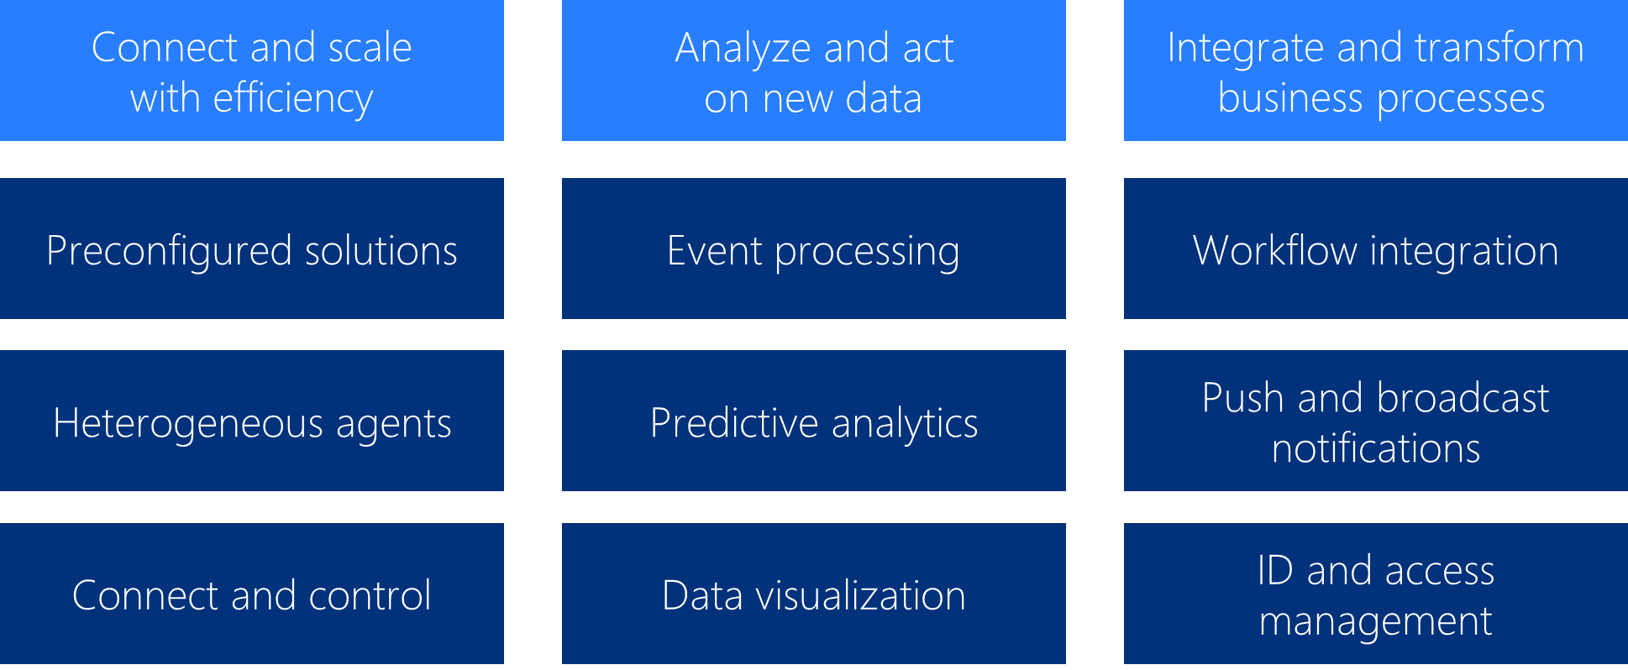
What you get with remote monitoring preconfigured solution
Azure IoT Suite
Web/Mobile App
Azure
Devices
Active Directory
Back end systems and processes
Storage blobs
DocumentDB
C# simulator
IoT Hub
Stream Analytics
Event Hub
Web Jobs
Logic Apps
Machine
Learning
Power BI
Notes:
Architecture diagram with reference to the three pillars of the preconfigured solutions.

